Slide 1
7. Performance Measurement
Intrusion Detection Module
Stephen Huang
Department of Computer Science
University of Houston
Notes:
Tom Fawcett, “An introduction to ROC analysis,” Pattern Recognition Letters 27 (2006) 861–874.

Slide 2
Overview
ROC curves
Cross Validation

Slide 3
ROC Curves
ROC: Receiver Operating Characteristics.
ROC curves are insensitive to changes in class distribution. If the proportion of positive to negative instances changes in a test set, the ROC curves will not change.
A discrete classifier produces only a single point in ROC space.

Slide 4
Terminologies
 |  | True Class
 |  | Pos | Neg
Hypothesized Class | Yes | True Positives (TP) | False Positives (FP)
 | No | False Negatives (FN) | True Negatives (TN)
P N

Slide 5
Terminologies
 |  | True Class
 |  | Pos | Neg
Hypothesized Class | Yes | True Positives (TP) | False Positives (FP)
 | No | False Negatives (FN) | True Negatives (TN)
P N

Slide 6
Terminologies
 |  | True Class
 |  | Pos | Neg
Hypothesized Class | Yes | True Positives (TP) | False Positives (FP)
 | No | False Negatives (FN) | True Negatives (TN)
P N

Slide 7
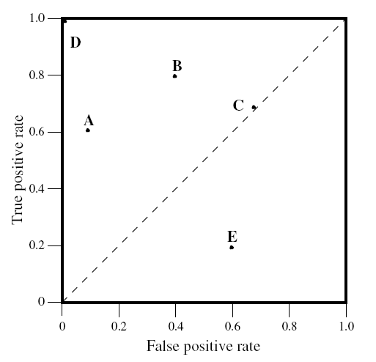
Interpreting ROC Curve

Slide 8
Interpreting ROC Curve
Perfect Classifier
Random Guessing

Slide 9
Interpreting ROC Curve
Expected to be Empty
Worse Than Random Guessing.

Slide 10
Interpreting ROC Curve
Negate the classifier!

Slide 11
Interpreting ROC Curve
Liberal
Conservative

Slide 12
Threshold
Some classifiers yield an instance probability or score, a numeric value that represents the degree to which an instance is a member of a class. Such a ranking or scoring classifier can be used with a threshold to produce a discrete (binary) classifier.
Given a threshold, one can define a classifier as “if the score > threshold, then a Yes else a No.”
For each classifier, we can plot a point in the ROC space.
Varying a threshold from -∞ to +∞ produces a curve through ROC space.

Slide 13
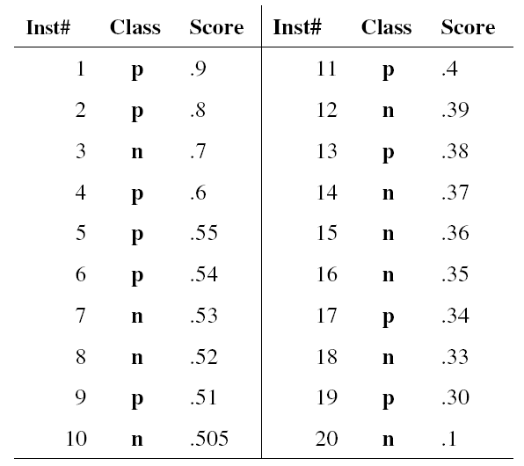
Example
p | n
0.900 | 0.700
0.800 | 0.530
0.600 | 0.520
0.550 | 0.505
0.540 | 0.390
0.510 | 0.370
0.400 | 0.360
0.380 | 0.350
0.340 | 0.330
0.300 | 0.100

Slide 14
Threshold
p | n
0.900 | 0.700
0.800 | 0.530
0.600 | 0.520
0.550 | 0.505
0.540 | 0.390
0.510 | 0.370
0.400 | 0.360
0.380 | 0.350
0.340 | 0.330
0.300 | 0.100

Slide 15
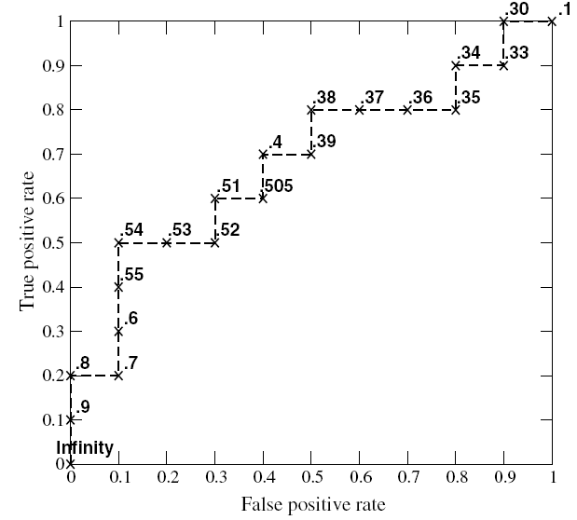
Threshold

Slide 16
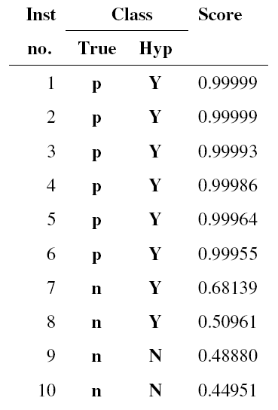
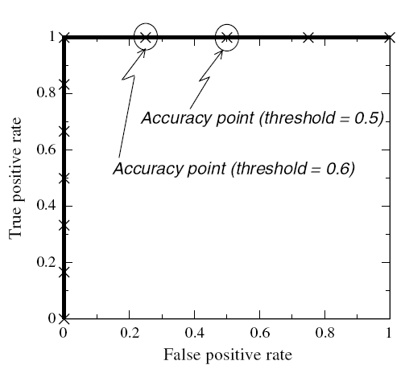
Problem

Slide 17
Precision

Slide 18
Recall

Slide 19
F-Measure

Slide 20
Accuracy

Slide 21
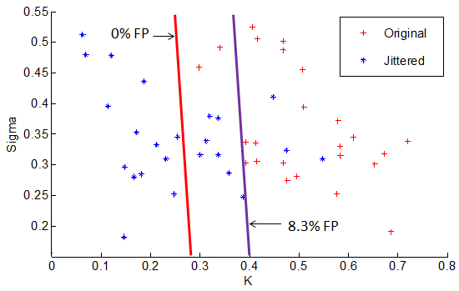
Produce a ROC
4.16% FP

Slide 22
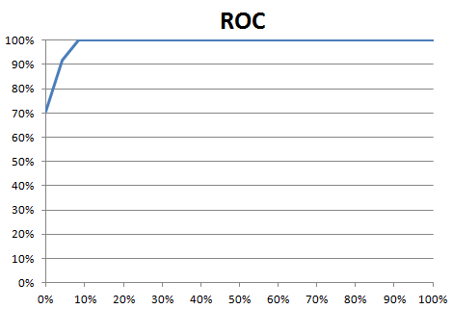

Slide 23
Cross Validation
Cross-Validation is a statistical method of evaluating and comparing learning algorithms by dividing data into two segments:
one used to learn or train a model and
the other used to validate the model.
In typical cross-validation, the training and validation sets must cross-over in successive rounds such that each data point has a chance of being validated against.
The basic form of cross-validation is k-fold cross-validation.
Other forms of cross-validation are special cases of k-fold cross-validation or involve repeated rounds of k-fold cross-validation.

Slide 24
Cross Validation
There are two possible goals in cross-validation:
To estimate performance of the learned model from available data using one algorithm. In other words, to gauge the generalizability of an algorithm.
To compare the performance of two or more different algorithms and find out the best algorithm for the available data, or alternatively to compare the performance of two or more variants of a parameterized model.
Type of cross-validation procedures:
Resubstitution Validation
Hold-Out Validation
K-Fold Cross-Validation
Leave-One-Out Cross-Validation
Repeated K-Fold Cross-Validation

Slide 25
Resubstitution Validation
In resubstitution validation, the model is learned from all the available data and then tested on the same set of data.
This validation process uses all the available data but suffers seriously from over-fitting.
That is, the algorithm might perform well on the available data yet poorly on future unseen test data.

Slide 26
Hold-Out Validation
To avoid over-fitting, an independent test set is preferred.
A natural approach is to split the available data into two non-overlapped parts:
one for training and
the other for testing.
The test data is held out and not looked at during training.
Hold-out validation avoids the overlap between training data and test data, yielding a more accurate estimate for the generalization performance of the algorithm.
The downside is that this procedure does not use all the available data and the results are highly dependent on the choice for the training/test split.
The instances chosen for inclusion in the test set may be too easy or too difficult to classify and this can skew the results.

Slide 27
Hold-Out Validation
Furthermore, the data in the test set may be valuable for training and if it is heldout prediction performance may suffer, again leading to skewed results.
These problems can be partially addressed by repeating hold-out validation multiple times and averaging the results, but unless this repetition is performed in a systematic manner, some data may be included in the test set multiple times while others are not included at all, or conversely some data may always fall in the test set and never get a chance to contribute to the learning phase.
To deal with these challenges and utilize the available data to the max, k-fold cross-validation is used.

Slide 28
k-fold Cross Validation
In k-fold cross-validation the data is first partitioned into k equally (or nearly equally) sized segments or folds.
Subsequently k iterations of training and validation are performed such that within each iteration a different fold of the data is held-out for validation while the remaining k - 1 folds are used for learning.
Fig. 1 demonstrates an example with k = 3. The darker section of the data are used for training while the lighter sections are used for validation.
In data mining and machine learning 10-fold cross-validation (k = 10) is the most common.

Slide 29
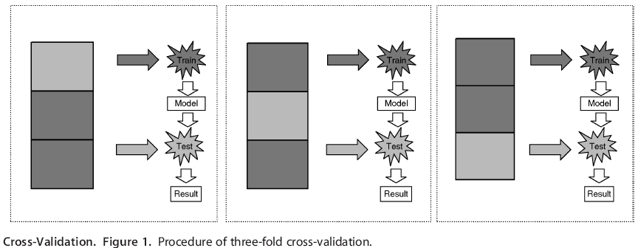
k-fold Cross Validation

Slide 30
Leave-One-Out Cross-Validation
Leave-one-out cross-validation (LOOCV) is a special case of k-fold cross-validation where k equals the number of instances in the data.
In other words in each iteration nearly all the data except for a single observation are used for training and the model is tested on that single observation.
An accuracy estimate obtained using LOOCV is known to be almost unbiased but it has high variance, leading to unreliable estimates.
It is still widely used when the available data are very rare, especially in bioinformatics where only dozens of data samples are available.

Slide 31
Repeated K-Fold Cross-Validation
To obtain reliable performance estimation or comparison, large number of estimates are always preferred.
In k-fold cross-validation, only k estimates are obtained.
A commonly used method to increase the number of estimates is to run k-fold cross-validation multiple times.
The data is reshuffled and re-stratified before each round.

